Slide 1
ADO.NET Entity Framework 5 for Real Web Applications
Adam Tuliper
Software Architect
Cegedim

Slide 2


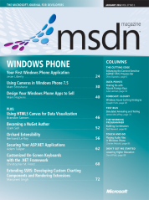
About Me
Adam Tuliper
Twitter: @AdamTuliper
CompleteDevelopment.blogspot.com
pluralsight.com author
MSDN Security Topics - December, January
Questions, Comments, Amazon Gift Cards,Beer, etc
adam.tuliper@gmail.com
The code is on github under adamtuliper

Slide 3


Slide 4
Why Entity Framework?
FAST Setup – Data code written for you
No manual managing of
Keys, Relationships (Order.Customer = customer)
Eager/lazy loading
Validation
Smart updates only for changed columns
No changes to object = No update to the database
All Major RDMS supported
No SQL Injection!!
Easy API (DbContext), Code First, and Enum support

Slide 5
What’s a ‘Real’ Web App?
Samples inadequate for ‘organized’ N-Tier apps
Beyond prototype or uber-basic CRUD
An app you don’t want all code in one project
An app that clearly has separate layers
Apps with Complex logic/views
An app that could benefit from Dependency Injection (See blog for complete usage with EF)

Slide 6
Everything you need
Install Entity Framework
Install-Package EntityFramework
EF Power Tools, SQL Compact Toolbox (opt)
Create your projects in layers
Web
Domain– Entities and Repository Interfaces
DataAccess (Contains repository implementation and Context)
Test Project
Design/Create Entities
Add Validation
Handle concurrency
Use Repository Pattern for ALL CRUD operations
Notes:
Use the universal provider or:
http://stackoverflow.com/questions/7575439/getting-own-ef-4-1-code-first-classes-to-work-with-net-membership
Go into your C:\Windows\Microsoft.NET\Framework\v2.xx or v4.xx\ and execute aspnet_regsql, this will launch a wizard that allows you to choose your database and it will add the stored procs and tables to allow membership to function.
Then you run the ASP.NET configuration wizard (the little toolbox icon at the top of your solution explorer) and then configure your roles and accounts. See this page and skip to the Configuring the website for membership and roles section.

Slide 7
Understanding EF Three important items
Context
The spork of Connection, Command, Transaction
Handles all CRUD to database
Parties after midnight cause honey badger don’t care
POCO
Entity States
Query easily via: context.Entry(customer).State
Added, Detached, Unchanged, Modified

Slide 8
It’s all about the context
Little Nancy was in the garden filling in a hole when her neighbor peered over the fence. Interested in what the little girl was up to, he politely asked, “What are you up to there, Nancy?”
“My goldfish died,” replied Nancy tearfully, without looking up, “and I’ve just buried him.”
The neighbor was concerned, “That’s an awfully big hole for a goldfish, isn’t it?”
Nancy patted down the last heap of earth and then replied, “That’s because he’s inside your stupid cat.”
:\

Slide 9
Background - POCOs
Isn’t it just a DTO?
100% Persistent Ignorant
 | POCO | DTO
Can contain business logic | X
Should not reference framework implementations (ex. EF libraries) | X | X
Designed to transfer between layers |  | X
Knows nothing of persistence | X | X
Transfers State |  | X
Notes:
EF mapping classes are the way to go instead of EF specific data annotations to remain ‘pure’ since they can change the behavior in relation to EF specific code.
The validation data annotations are ok as they do not effect this.

Slide 10
Model First/Database First
Pros
Visual Designer -> Architectural documentation
Easy code regeneration with model or db changes
Very fast implementation
Cons
May not prefer to deal with XML based EDMX file
Some may feel loss of control without ‘pure’ code
Please use: ADO.NET DbContext Generator T4 Templates

Slide 11
Code First
Pros
POCO by default – simple!
Can specify initializers to create database
Fluent API or clean attributes for validation
Cons
No Visual Designer
No direct stored procedure support for operations.
Easily can call Context.Database.SqlQuery(..) in repository though
Requires only model(s) and a context class.
Can reverse engineer an existing database

Slide 12
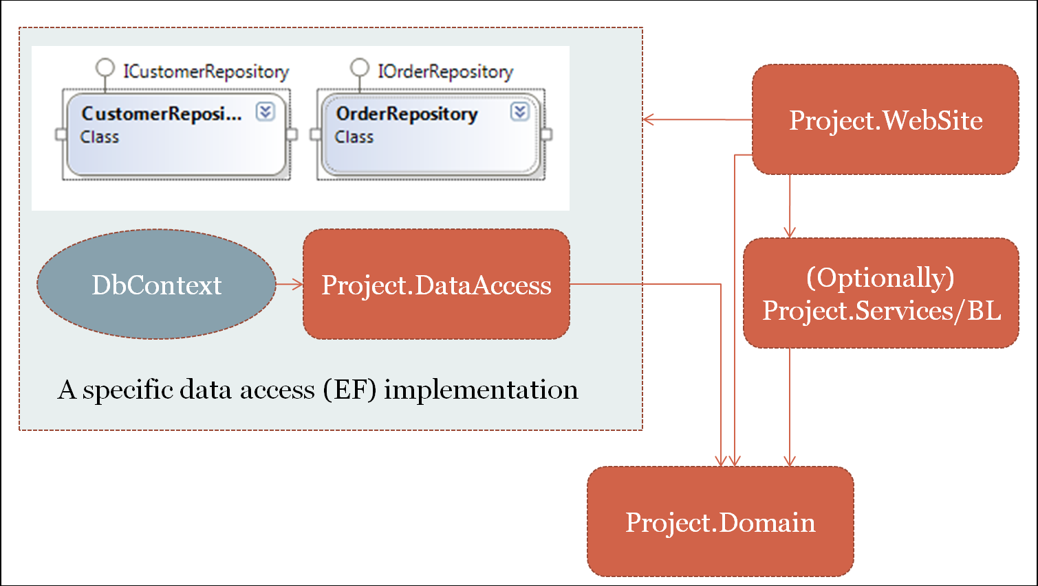
Basic Architecture
Notes:
Orange are projects
Your business objects (Customer, for ex) contain NO persistence logic!

Slide 13
Reposi-what?
Repository is defined as “an abstraction that provides us with persistence ignorance and a separation of concerns where the responsibility of persisting domain objects is encapsulated by the Repository thus leaving the domain objects to deal entirely with the domain model and domain logic.

Slide 14
‘Real’ Web Considerations
Use the Repository Pattern!
Swappable (think Azure)
Single point of change (to/from stored proc)
Convert all collections to IEnumerable first
Avoid deferred execution outside of context scope:
var customer = ctx.Customers;
var customer = ctx.Customers.ToList();
New context per each request - Do not cache.
Use Universal Membership provider
Supports SQL Server, SQLCE, SQL Express, SQL Azure
Install-Package MiniProfiler.EF
Notes:
See the web forms 4.5 project for an example of ToList or simply look at the CustomerRepository.cs GetAll method

Slide 15
MVC Considerations
For Views, don’t use EF entities, map to ViewModels
Automapper is your friend http://automapper.org/
ViewModel + AutoMapper maps entities for GET only
DbContext is not thread safe.
Instantiate a new one per request in constructor or via DI
Do not cache it or use a static instance.
Dispose Context when done (DI helps)
Do not throw all EF code into controller
MVC Controller and code behinds should be THIN & Organized!
Greatly helps testing
Notes:
See the CustomerController.Index method, mapping via lambda, repository.
See automap attribute on CustomerController.Edit
Don’t let entities leak out onto the page unless you don’t care about testing and this is a simple prototype. Always use ViewModel. If you have to use SelectLists you end up using ugly workarounds without a viewmodel (ViewBag or uglier code in the view to create the select list)
Edit a customer, notice get vs postback. We don’t map on post,simply assign properties. Automapper isn’t meant to map both ways here. EF’s property state wont correctly get set as ‘modified’ if you map from a viewmodel INTO an entity framework object.
The db code is not in the presentation layer, a controller is an orchestrator for the UI.

Slide 16
Web Forms Considerations
Can ‘magically’ use EntityDataSource/ObjectDataSource
I recommend handling context lifetime yourself
Data binding must occur in the context scope unless ToArray/ToList()
Do not add entities to ViewState
ASP.NET 4.5 now has strongly typed controls
Can easily use ViewModels and AutoMapper
Notes:
EntityDemoSite.WebformsAspNet45, Default.aspx
Or for other examples see the EntityDemoSite project (change port mappings below to whatever it starts as once you change web forms to be the default startup project)
http://localhost:64097/DataBindList.aspx
http://localhost:64097/Customers.aspx leave out a field so the validators fire. I don’t like the magic objectdatasource binding, but some like it for lack of writing code ‘simplicity’ if you want to call it that.
http://localhost:64097/CustomerAdd.aspx
Show: CheckForEfExceptions
-if using objectdatasource your context must be instantiated inside of the repository! No DI integration here.

Slide 17
Validations
All work in MVC or Web Forms for server side validation
Fluent API (Integrated in MVC4, not in MVC3)
Data Annotations
IValidateableObject
All triggered by context.SaveChanges()
EF throws DbEntityValidationException
Client side validation?
Must use data annotations for MVC
Web Forms 4.5 supports data annotations
Otherwise no tight integration
Notes:
Data annotations not directly integrated into web forms but will raise dbentityvalidtionexception, same as if MVC on entity but using viewmodels.
Create customer Ivalidateable interface.
If using MVC, ModelState will catch Data annotations, IValidateableObject but not fluent (yet) mvc4 does handle these (Ive tested DbEnityExceptions mapping to ModelState errors which is ok, but had problems with timestamps)

Slide 18
Handling Concurrency
Automatic via [TimeStamp] attribute & rowversion type
Must catch DbUpdateConcurrencyException
In both MVC & Web Forms
MVC -manually include model’s hidden timestamp field
Html.HiddenFor(o=>o.TimeStamp)
Web Forms various methods
Store timestamp as hidden field on form
GridView: DataKeyNames="CustomerId,Timestamp"
Notes:
-Demo timestamp code.
Open /Customers for the mvc app. Edit the same customer in two windows save one, then save the other – you should receive a nice error message and each property showing you what’s changed.
This is because of the action filter I added in global.asax.cs
From one of my stack overflow posts:
I wanted to add some more info on this, seems concurrency is handled in two separate ways (at least). One I believe is simply to add a timestamp column to your table and decorate its property with the [TimeStamp] attribute. EF will automatically then compare this value in it's where clause. The other case according to the Contoso example: "you would have to mark all non-primary-key properties in the entity for concurrency tracking by adding the ConcurrencyCheck attribute to them. That change would enable the Entity Framework to include all columns in the SQL WHERE clause of UPDATE statements." – Adam Tuliper Sep 25 '11 at 15:22

Slide 19
Automatic Data Migrations
Provides mechanism to migrate model changes to DB
Migrations are handled from the package manager
Enable-Migrations -EnableAutomaticMigrations
Update-Database
Can downgrade to a past migration and remove columns
Notes:
Add a new property to customer class
Run Enable-Migrations –EnableAutomaticMigrations
3. Update-Database - Script or Update-Database to do the changes.
Install-Package EntityFramework
Update-Database –Script
Update-Database –Force
Enable-Migrations
Install-Package Unity.MVC3
Enable-Migrations -EnableAutomaticMigrations
Install-Package MiniProfiler.EF

Slide 20
Thanks!!
http://completedevelopment.blogspot.com/2012/06/dependency-injection-with-entity.html
completedevelopment.blogspot.com/2012/06/unit-of-work-pattern-with-entity.html
www.asp.net/web-forms/tutorials/aspnet-45/getting-started-with-aspnet-45-web-forms/create_the_data_access_layer
CompleteDevelopment.blogspot.com
Twitter: @AdamTuliper
Questions, Comments, Gift Cards, Beer
adam.tuliper@gmail.com

